Slide 1




智慧運算技術導論 自然語言處理篇 - Transformer
林英嘉 (Ying-Jia Lin)
長庚大學人工智慧學系
2026/01/27
Slido
# AIMD (Link)

Slide 2
Outline
Contextual Embedding 的概念
RNN
Transformer
BERT

Slide 3
Problems of Traditional Word Embeddings
Out-of-vocabulary problem
Model architecture for down-stream applications
Context-dependent representations

Slide 4
The Out-of-vocabulary Problem
Before training word embeddings, words are split by whitespaces for English corpora
Vocabulary
(假設字典的內容由a排到z)
apple
300-dimensional vector
...
jobs
300-dimensional vector
Word2vec
(Embeddings)
...
jobs
300-dimensional vector
...
QAQ
?
...
如果字沒有出現在字典中 (可能此字不存在於訓練資料)，那它就不會有對應的字向量

Slide 5
Sub-word Tokenization (Byte Pair Encoding)
Byte Pair Encoding (BPE)^{[1]} is a sub-word (子詞) tokenization technique used to handle rare words by breaking them into more frequent sub-word units.
Example sentence:
I printed Hello world.
Traditional word tokenization
Traditional with BPE
I
printed
Hello
world
I
prin
ted
Hell
o
world
分詞方法的決定是無監督式的
[1] Sennrich et al. "Neural Machine Translation of Rare Words with Subword Units." ACL 2016.

Slide 6
Sub-word Tokenization 的好處
With sub-word tokenization algorithms like BPE, we can handle representations for unknown words (or mis-spelled words).
In machine translation , the compound word issues between source and target languages can be alleviated.
State-of-the-art pre-trained language models (e.g., GPT-3, BERT) adopt sub-word tokenization algorithms before pre-training.

Slide 7
Problems of Traditional Word Embeddings
Out-of-vocabulary problem
Model architecture for down-stream applications
Context-dependent representations

Slide 8
單純使用 Word Embeddings 並無上下文知識
[Recap] Word2Vec 的範例長相:
Dimension size (e.g., 300)
apple -0.110960 0.016115 -0.004809 0.033589 0.121455 …
banana -0.027713 -0.015676 0.003314 0.077602 0.159718 …
…
…
…
Vocabulary size
(e.g., 30,000)
open a bank account
on the river bank
the same word vector

Slide 9
語言的模式
⭐️ 上下文非常重要
小明昨天遇到小美，他對她說：「下次一起去看電影吧！」
，請問小明下次想去跟誰看電影？
句子1：
「庭院深深深幾許」，請問有幾個深？
句子2：

Slide 10
Contextual Embedding

Slide 11
深度學習常見模型架構
CNN
(著重局部資訊)
RNN
(著重記憶力)
Transformer
(著重全局資訊與記憶力)
i
love
deep
learning
i
love
deep
learning

Slide 12
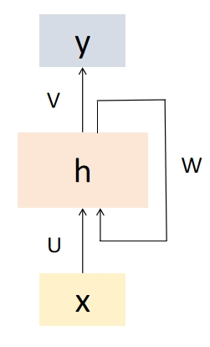
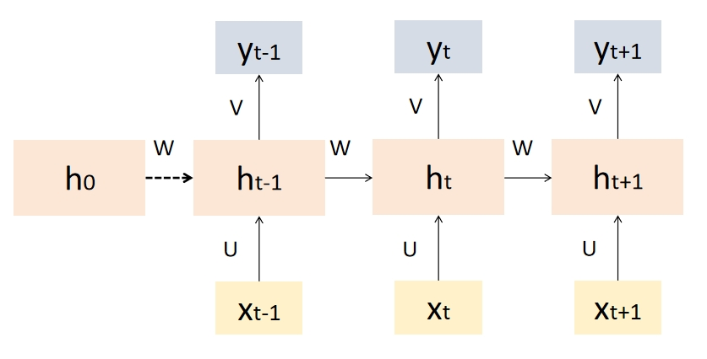
Recurrent Neural Networks (RNN)
Recurrent Neural Networks (RNNs) are a type of artificial neural network designed to handle sequential data by capturing temporal dependencies.
RNN 的“遞迴”是指它在每一個時間步中重複使用相同的參數（同一組權重），並把先前的隱藏狀態傳到下一個時間步

Slide 13
RNN 的記憶力意義
得知第一個字為「庭」
已經包含了「庭院深」的資訊
已經包含了「庭院深深深幾許」的資訊
h₀
h₁
h₂
h₃
...
h₆
h₇
...
庭
院
深
幾
許

Slide 14
RNN 以文字接龍進行訓練
EOS: End of Sentence
$$P(EOS|\text{庭}, 院,深,深,深,幾, 許)$$
$$P(院|\text{庭})$$
$$P(深|\text{庭}, 院)$$
$$P(深|\text{庭}, 院,深)$$
$$P(許|\text{庭}, 院,深,深,深,幾)$$
院
深
深
許
EOS
h₀
h₁
h₂
h₃
...
h₆
h₇
...
庭
院
深
幾
許
log(
)
目標函數： $P(院|\text{庭})×P(深|\text{庭}, 院)×P(深|\text{庭}, 院,深)×$... $×P(EOS|\text{庭}, 院,深,深,深,幾, 許)$

Slide 15
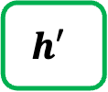
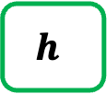
Text Generation with RNN
Hidden size: 100
Vocab
Prob
a
...
apple
...
b
...
banana
...
elephant
...
eraser
...
...
zoo
0.0001
...
0.600
...
0.0001
...
0.0003
...
0.300
...
0.05
...
...
0.0001
$$h$$
Classification Layer
(Hidden size Vocab_size)
RNN
RNN
RNN
$$h′$$
Vocab
size
I
love
an

Slide 16
Bidirectional RNNs
y₁
y₂
y₃
y_{n}
Concatenation
RNN
RNN
RNN
RNN
RNN2
RNN1
RNN
RNN
RNN
RNN
x₁
x₂
x₃
x_{n}

Slide 17
Bidirectional RNNs for Sequence Classification
The final hidden units from the forward and backward passes are combined to represent the entire sequence.
This combined representation serves as input to the subsequent classifier.
FFN
Concatenation
RNN
RNN
RNN
RNN
RNN2
RNN
RNN
RNN
RNN
RNN1
x₁
x₂
x₃
x_{n}

Slide 18

RNNs for Sequence Classification
This movie was awful. The ending was absolutely horrible.
Classifier
Positive
Negative
FFN
h_{n}
h₀
RNN
RNN
RNN
RNN
x₁
x₂
x₃
x_{n}

Slide 19
為什麼我們需要序列模型?
Contextual Embedding
(具備上下文知識的表達)
RNN
RNN
RNN
RNN
RNN
RNN
RNN
RNN
open
a
bank
account
on
the
river
bank
Same word embedding

Slide 20
RNN 與 CNN 作為序列模型的問題
問題：RNN 難以平行化
問題：CNN 著重局部資訊
RNN
RNN
RNN
RNN
Pooling
CNN
CNN
CNN
open
a
bank
account
open
a
bank
account

Slide 21

Transformer

Slide 22
Tokens vs. words
token 是 (語言) 模型在每個時間點處理的單位
word 是語言本身的單位
token 可以是 word，也可以是 sub-word
一個 word 可以是一個 token，但單純講 token 不一定指的是 word
Traditional word tokenization
Sub-word Tokenization
I
printed
Hello
world
I
prin
ted
Hell
o
world

Slide 23
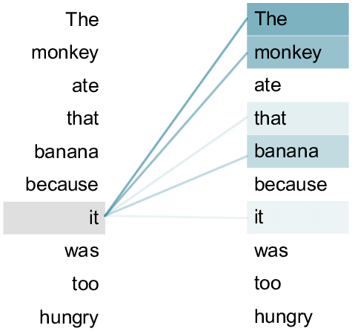
Transformer
Source: An example of the self-attention mechanism following long-distance... | Download Scientific Diagram (researchgate.net)
Transformer 來自論文：Attention Is All You Need (Vaswani et al., 2017)
Transformer 內部的主要機制為 Self-attention
Self-attention: 句子內的每個 token 自己跟自己做 attention
attention 進行的過程需要主動與被動
Self-attention
open
a
bank
account

Slide 24

Self-attention 動畫
Figure source: https://research.google/blog/transformer-a-novel-neural-network-architecture-for-language-understanding/

Slide 25
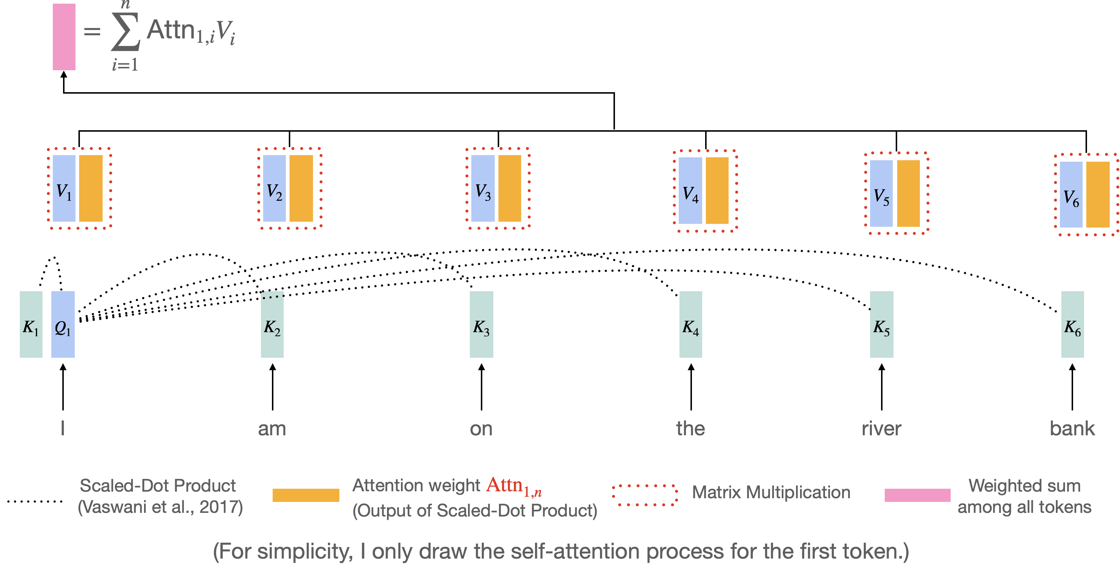
Self-Attention (Transformer) 過程
Vaswani et al. "Attention is all you need." NeurIPS 2017.
https://research.google/blog/transformer-a-novel-neural-network-architecture-for-language-understanding/

Slide 26
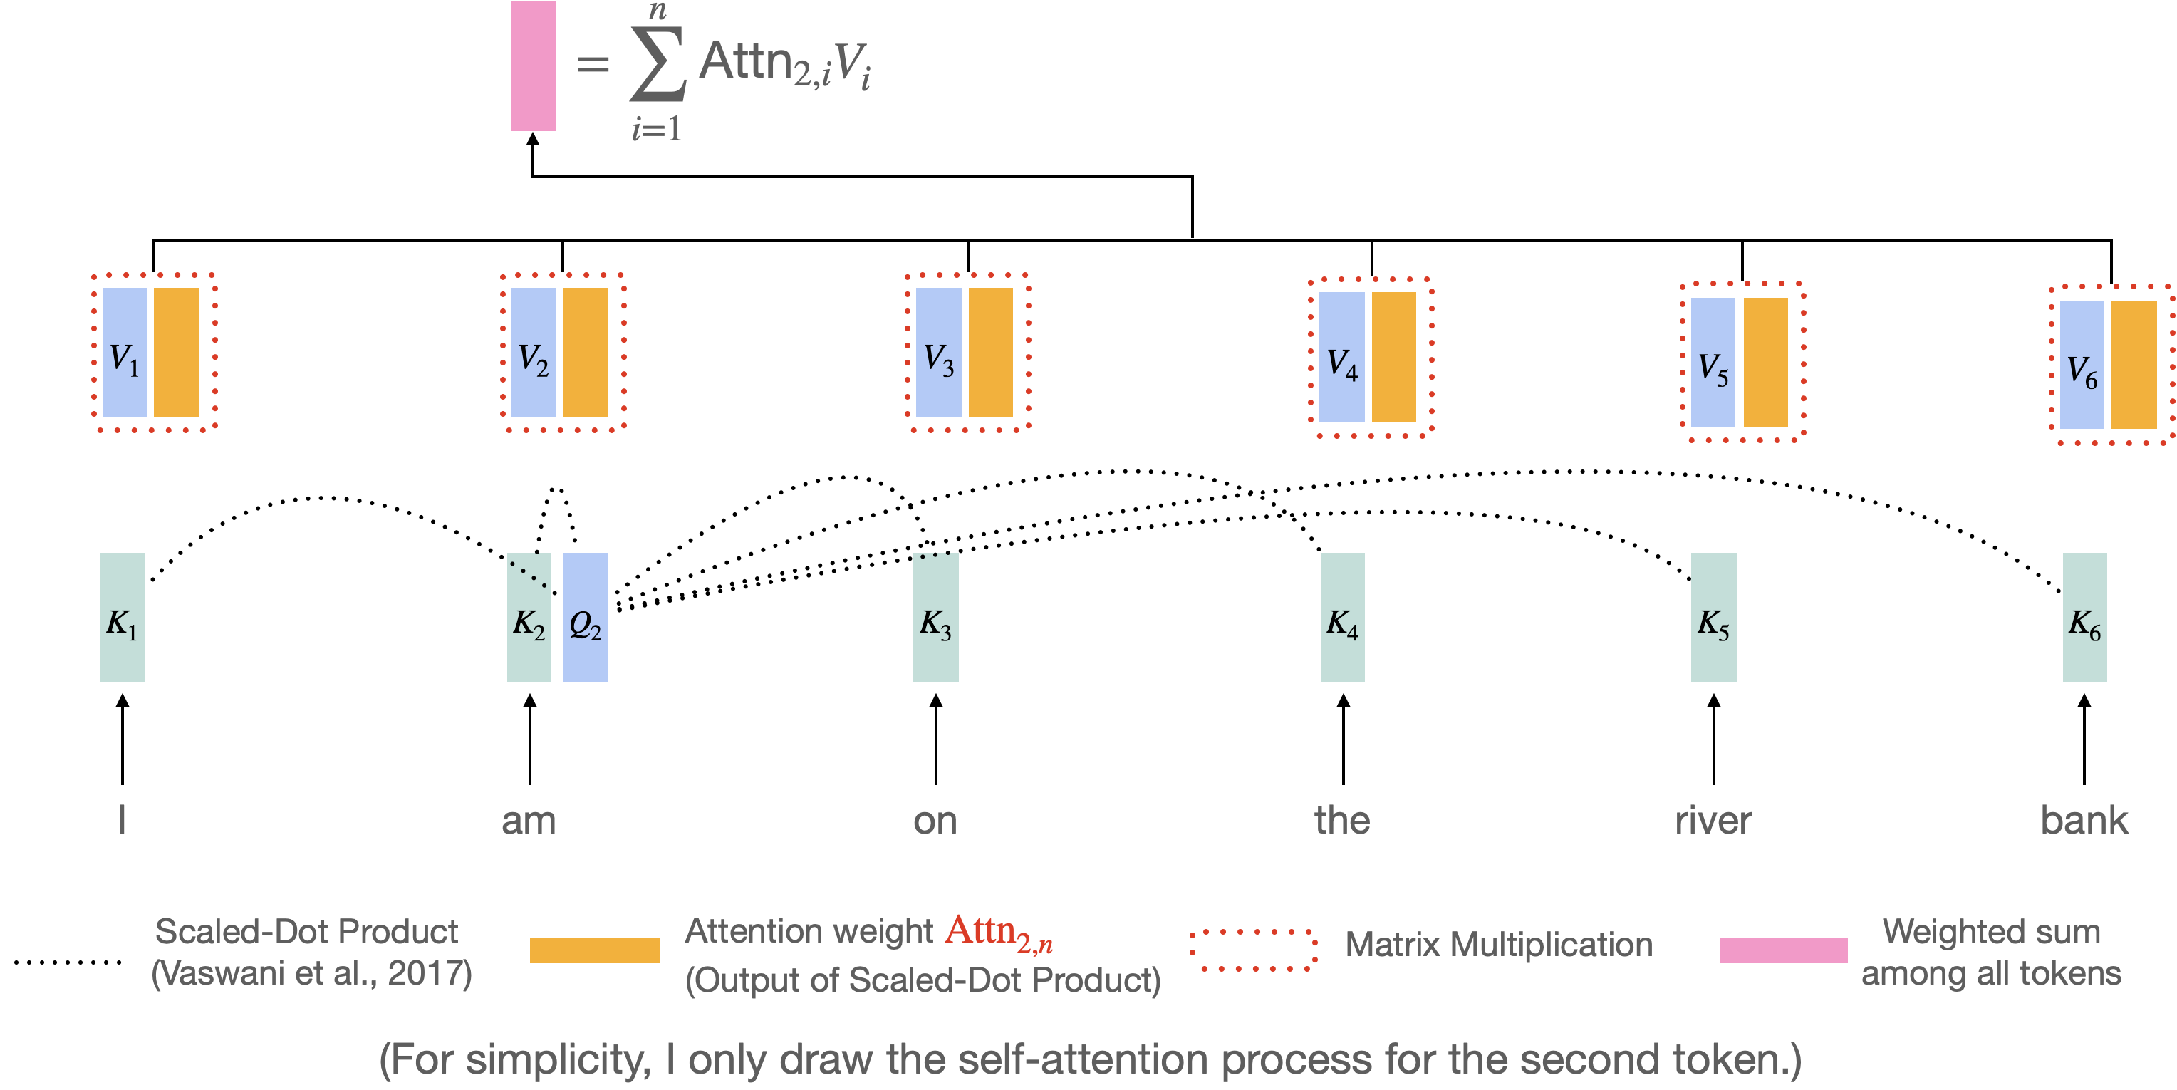
Self-Attention (Transformer) 過程
Vaswani et al. "Attention is all you need." NeurIPS 2017.
https://research.google/blog/transformer-a-novel-neural-network-architecture-for-language-understanding/

Slide 27

QKV 的比喻
Vaswani, Ashish, et al. "Attention is all you need." NeurIPS (2017).
Query
Key
Value
Query: (主動) 查詢的關鍵字；Key: (被動) 查詢的對象
Value: 值，關鍵字與對象的匹配程度
Notes:
https://stats.stackexchange.com/questions/421935/what-exactly-are-keys-queries-and-values-in-attention-mechanisms

Slide 28
Query (Q), Key (K), and Value (V)
t = 1
Self-attention 的過程
h₁
Weighted sum
a₁
a₂
a₃
a₄
q₁
k₁
v₁
q₂
k₂
v₂
q₃
k₃
v₃
q₄
k₄
v₄
🎯
e₁
I
e₂
print
e₃
Hello
e₄
world

Slide 29
Query (Q), Key (K), and Value (V)
t = 2
Self-attention 的過程
h₁
h₂
Weighted sum
a₁
a₂
a₃
a₄
q₁
k₁
v₁
q₂
k₂
v₂
q₃
k₃
v₃
q₄
k₄
v₄
🎯
e₁
I
e₂
print
e₃
Hello
e₄
world

Slide 30
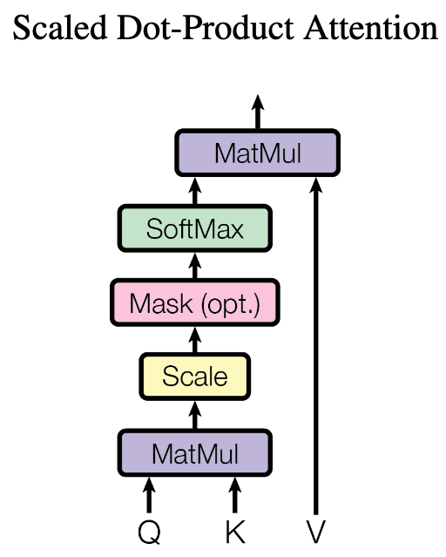
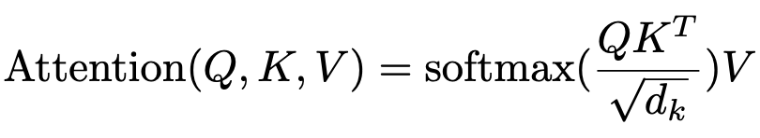
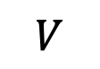
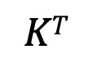
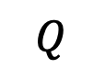
為什麼 Transformers 可以平行化？
d_{q} = d_{k} = d_{v}
(自注意力機制可以利用矩陣乘積來進行平行化計算)
$$Q$$
$$KT$$
$$V$$
Q₁
V₁
K₁
K₂
K₃
Q₂
V₂
Q₃
V₃
N x d_{k}
d_{k} x N
N x d_{k}
Q₁
K₁
V₁
Q₂
K₂
V₂
Q₃
K₃
V₃
e₁
I
e₂
printed
e₃
Hello

Slide 31
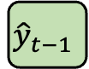
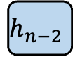
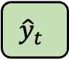
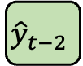
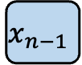
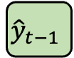
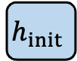
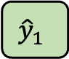
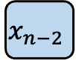
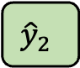
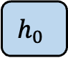
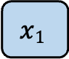
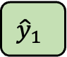
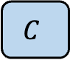
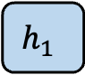
Encoder and Decoder
輸出是 hidden states
輸出是 sequence (文字)
$${\hat{y}}_{1}$$
$${\hat{y}}_{2}$$
……
$${\hat{y}}_{t−1}$$
$${\hat{y}}_{t}$$
$$h_{0}$$
$$h_{1}$$
……
$$h_{n−2}$$
$$C$$
FFN (linear layer(s))
Encoder
Decoder
$$h_{init}$$
……
_
$${\hat{y}}_{1}$$
……
$${\hat{y}}_{t−2}$$
$${\hat{y}}_{t−1}$$
_
$$x1$$
$$x_{n−2}$$
$$x_{n−1}$$
(Start)
(Start)
Input sequence
(Encoder 的輸出有很多種被Decoder運用的方式)

Slide 32
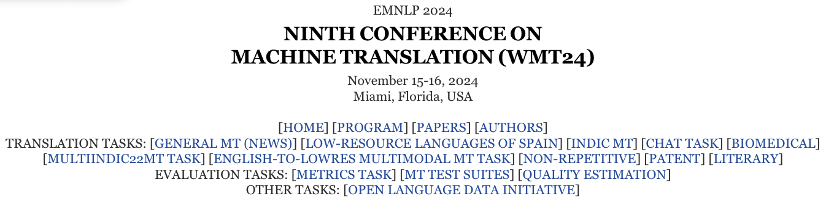
Machine Translation
Translation, EN-ZH (WMT-19 dataset ^{[1]})
Machine Translation Model
Yet not nearly enough has been invested in this effort.
但目前這方面的投入還遠遠不夠。
Figure source: https://www2.statmt.org/wmt24/mtdata/
[1] https://huggingface.co/datasets/wmt/wmt19/viewer/zh-en

Slide 33
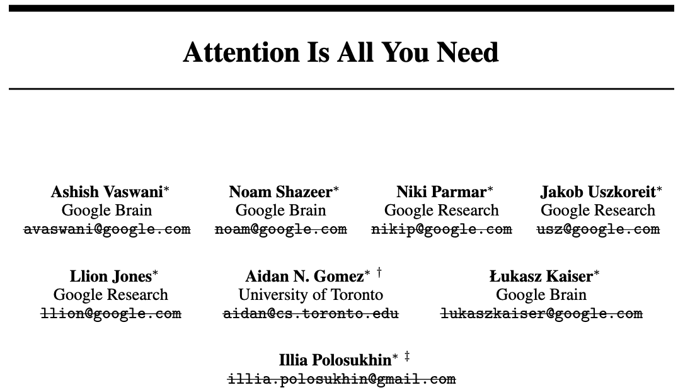
Essential AI
Anthropic
Inceptive
Cohere
Sakana AI
OpenAI
NEAR
https://arxiv.org/abs/1706.03762v6

Slide 34
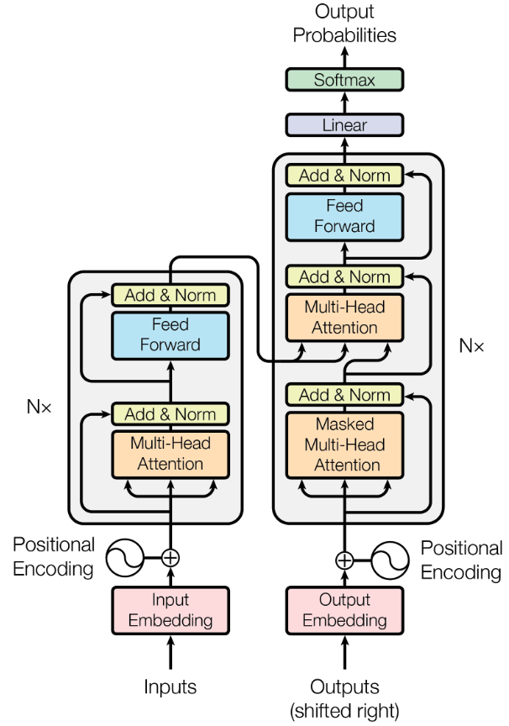

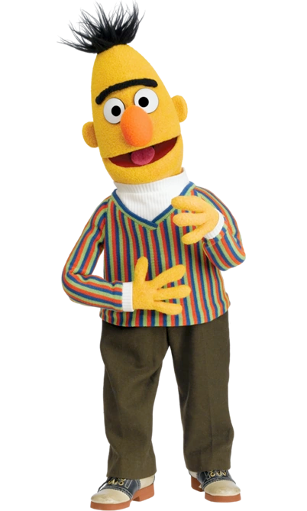
Transformer 架構的後續應用
Generative Pre-training (GPT) series
BERT (Bidirectional encoder representations from transformers)
Devlin et al., 2018
N=12
(GPT)
Encoder
(BERT)

Slide 35
先 Pre-training，再 Fine-tuning
Pre-training
Fine-tuning
在大量資料上進行訓練，通常是自監督式 (Self-Supervised Training, SSL)
在目標資料上 (Down-stream tasks, 下游任務) 進行訓練，通常是監督式 (Supervised Training)，也就是需要有標註的資料才能進行模型訓練

Slide 36
Model Training: Pre-training and Fine-Tuning
Step1: Pre-training (use large-scale corpora)
Model (e.g., Word2vec, BERT)
Open a [MASK] account
bank
Step2: Fine-Tuning (use datasets from target tasks)
Model (e.g., Word2vec + RNN; BERT + Classifier)
It was a good movie!
Positive
Devlin, Jacob, et al. "BERT: Pre-training of Deep Bidirectional Transformers for Language Understanding." NAACL 2019.

Slide 37
BERT (Bidirectional Encoder Representations from Transformers)
BERT 有兩種預訓練任務：
Masked Language Modelling
Next Sentence Prediction
bank
binary classification
BERT
(Transformer Encoder)
BERT
(Transformer Encoder)
[CLS]
open
a
[MASK]
account
[SEP]
[CLS]
study
hard
[SEP]
plz
[SEP]
Devlin, Jacob, et al. "BERT: Pre-training of Deep Bidirectional Transformers for Language Understanding." NAACL 2019.

Slide 38
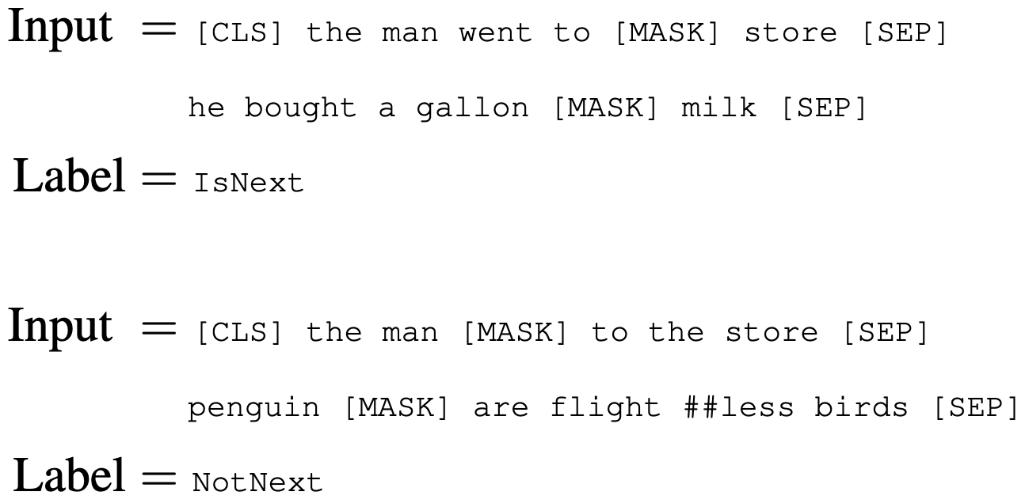
Next Sentence Prediction (NSP)
二元分類任務
目標：使模型能夠理解不同語句之間的關聯性

Slide 39
Fine-tuning BERT (Sentence Classification)
Single-sentence classification
Sentence pair classification
class
class
Linear
Linear
BERT
(Contextual Embedding)
BERT
(Contextual Embedding)
[CLS]
I
love
this
movie
[SEP]
[CLS]
Fantastic
[SEP]
Good
movie
[SEP]
Sentence1
Sentence2

Slide 40
Summary - Key information
Self-supervised Learning 的訓練方式是從資料中取得「答案」
節省大量標註成本
適用於大規模未標資料
自然語言處理領域以預測文章或句子中的下一個字為 SSL 的主要方法

Slide 41
Thank you!
長庚大學人工智慧學系 林英嘉
✉️ yjlin@cgu.edu.tw

